Slide 1





Sprint Credit Union Member
Cash Rewards Program

Slide 2
Table of Contents
Marketplace snapshot
Why Sprint?
Sprint Credit Union Member Cash
Rewards Program
Rewards
  Member value
  Credit union value
Enroll today
OUR MISSION:
Enhance the value of credit union membership with Sprint® and Love My Credit Union® Rewards today!

Slide 3

Marketplace snapshot
On average, there are
2.5 phones per household
2.5 million people are in the market for a phone at any given time
Average age that children receive their first phone: 10 years old

Slide 4

Sprint’s brand mission:
We help people
get better every day.
Aligns with the credit union philosophy of “people helping people”.

Slide 5
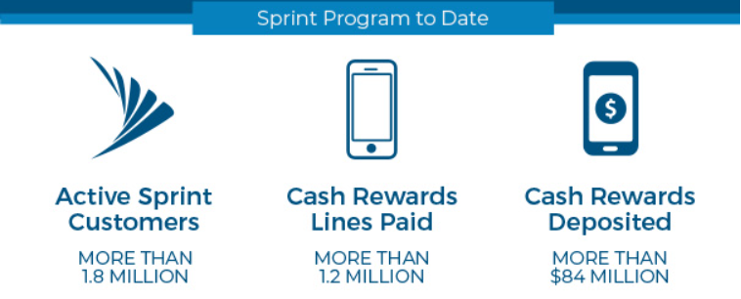
Trusted credit union partner
14+ years of partnership.
This unique program, available through Love My Credit Union Rewards and Sprint, has made a positive impact on the credit union industry.

Slide 6
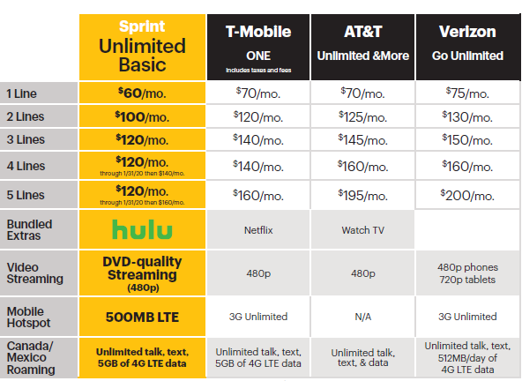
Why Sprint?
Your members deserve the best price.
Notes:
Great member value

Slide 7
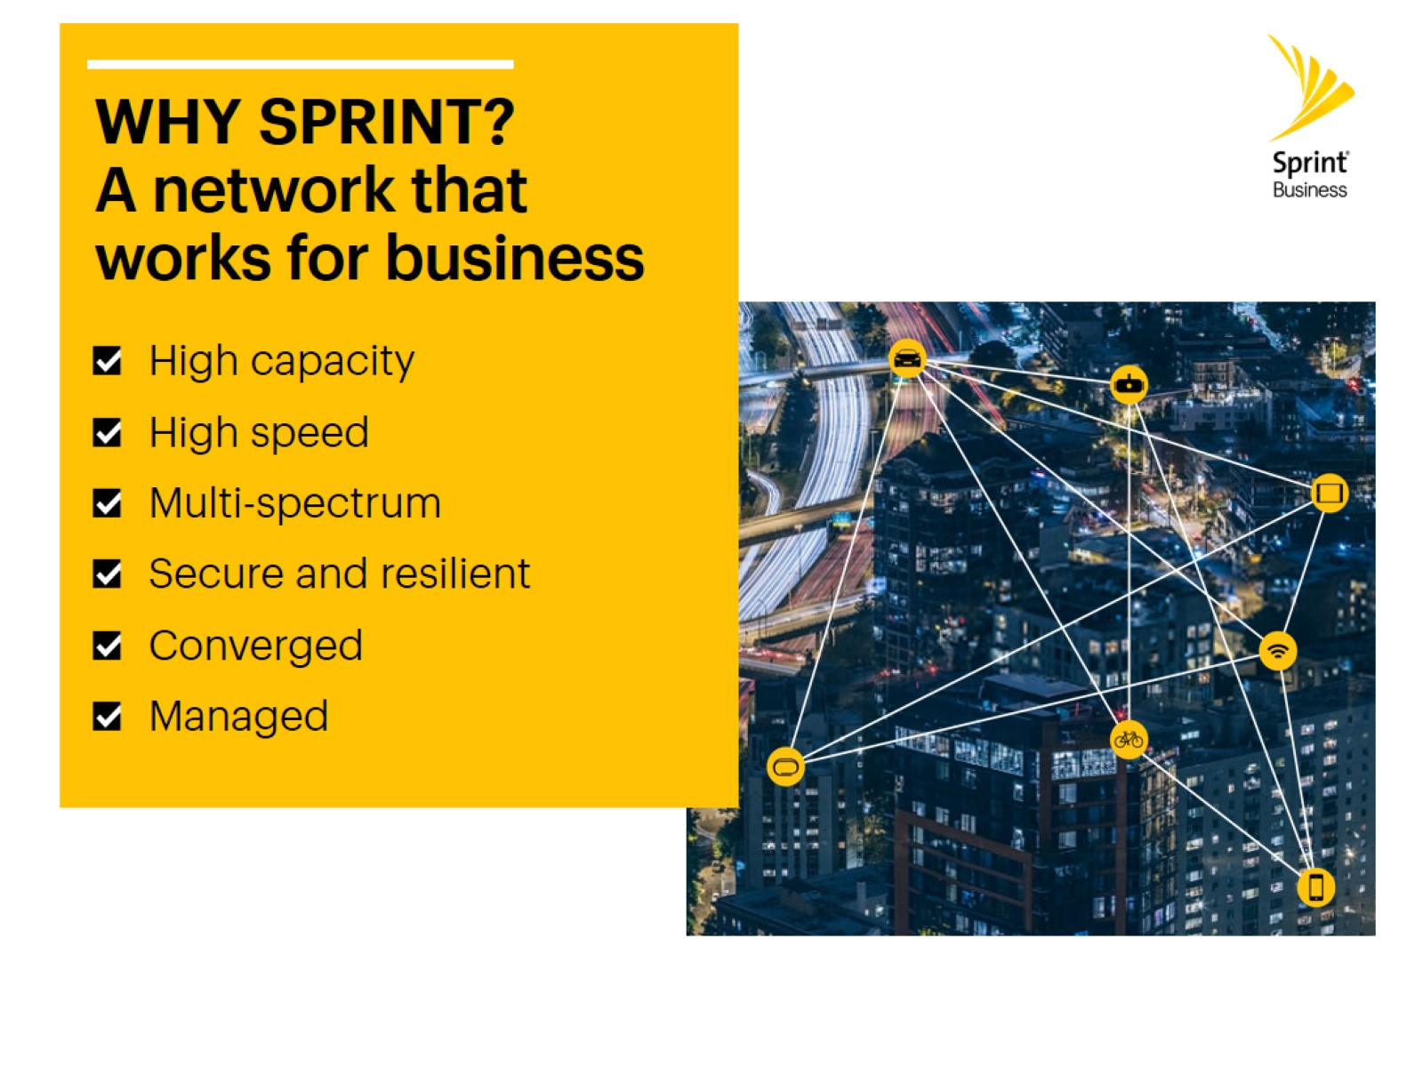
Great value and service
Sprint works for business.
High

Slide 8
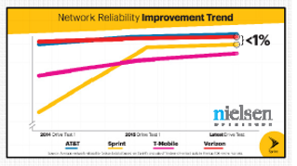
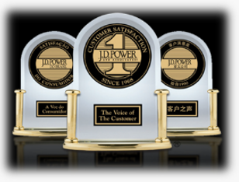
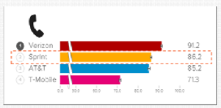

Network reliability has never been better
People are noticing.
Sprint is now within 1% of Verizon
in network reliability. Why would
you pay twice as much for a
1% difference?
Sprint finished second in J.D. Power 2016 U.S. Wireless Network Quality Performance Study
Sprint has beaten AT&T for the second time in a row for call quality as measured by RootMetrics
PC Magazine: “Sprint is Back”

Slide 9
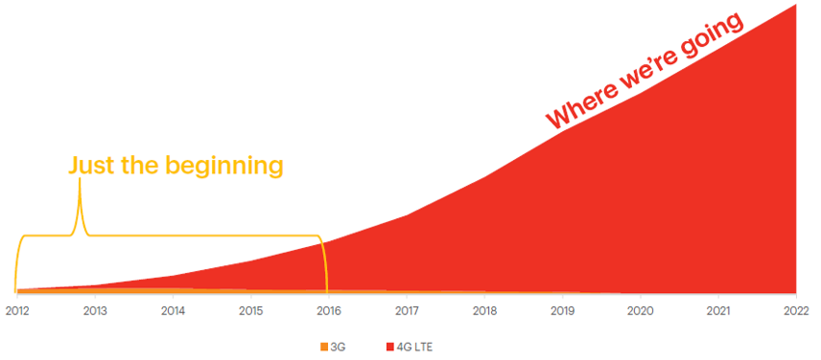
Poised for continued success
Sprint demand for 4G LTE:
4G LTE coverage is increasing, driving more demand for 4G LTE.

Slide 10


Enhance the value of credit union membership.
Sprint Credit Union Member Cash Rewards Program

Slide 11
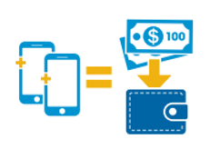
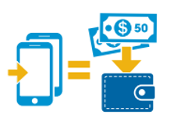
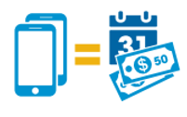
Program overview
Sprint’s best credit union offer EVER!
Members get a $100 cash reward for a limited time, for every new line when you switch to Sprint.
Plus, get a $100 loyalty cash reward every year.
How to sign up:
Become a Sprint customer and mention you’re a credit union member.
Register at LoveMyCreditUnion.org/ SprintRewards
Allow up to six to eight weeks to see cash rewards directly deposited into your credit union account!

Slide 12

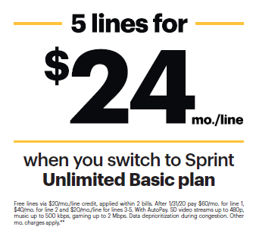
Features and benefits
Additional member value:
Can be combined with most Sprint promotions
Program participants receive an additional
25% discount on select accessories in stores

Slide 13
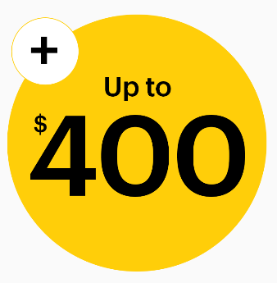
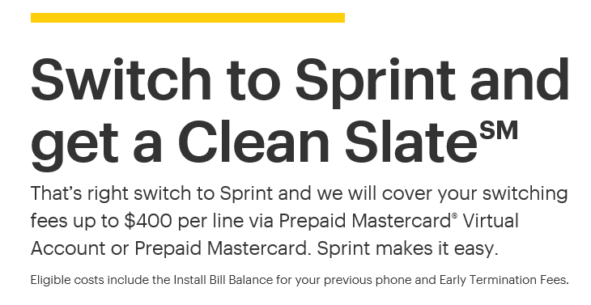
The perfect time to switch

Slide 14

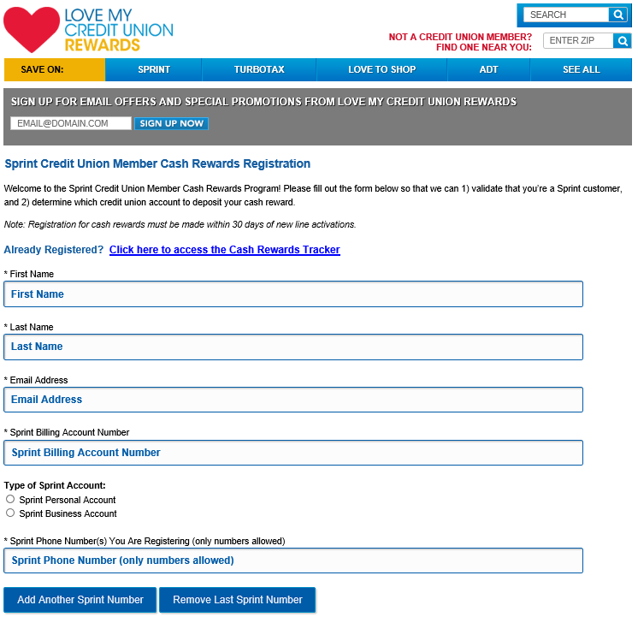
Registration is easy and secure
And it benefits you!
  Cash rewards are deposited directly into credit union member’s account within six to eight weeks of registration and validation
  Annual loyalty reward also deposited directly into credit union member’s account
  Rest assured, the registration process is an online form that is easy, safe and secure for your members to complete
14

Slide 15

Build loyalty.
Stay relevant.
Grow membership.
…all while earning non-interest income

Slide 16

A dynamic program
The value to credit unions:
Grow membership by partnering locally with Sprint
Maximize membership through this exclusive offer that’s only available to credit union members and valid in conjunction with most Sprint promotions
Cash rewards deposited into a credit union account within six to eight weeks of registration and validation
Track sales and activations in the Love My Credit Union Rewards Partner Center
Earn non-interest income through a performance-based revenue structure
Free marketing materials, including emails, web banners, social media assets and more!
Sprint handles all member service needs
Love My Credit Union Rewards handles verifications and deposits

Slide 17
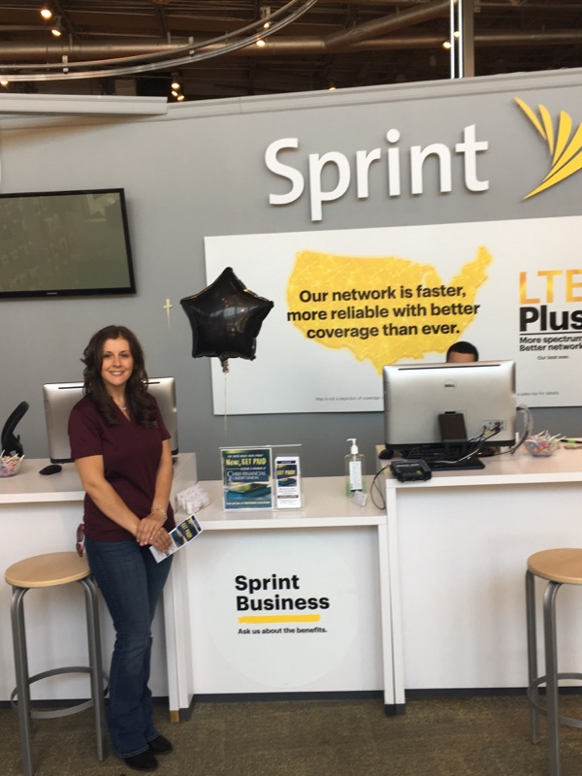
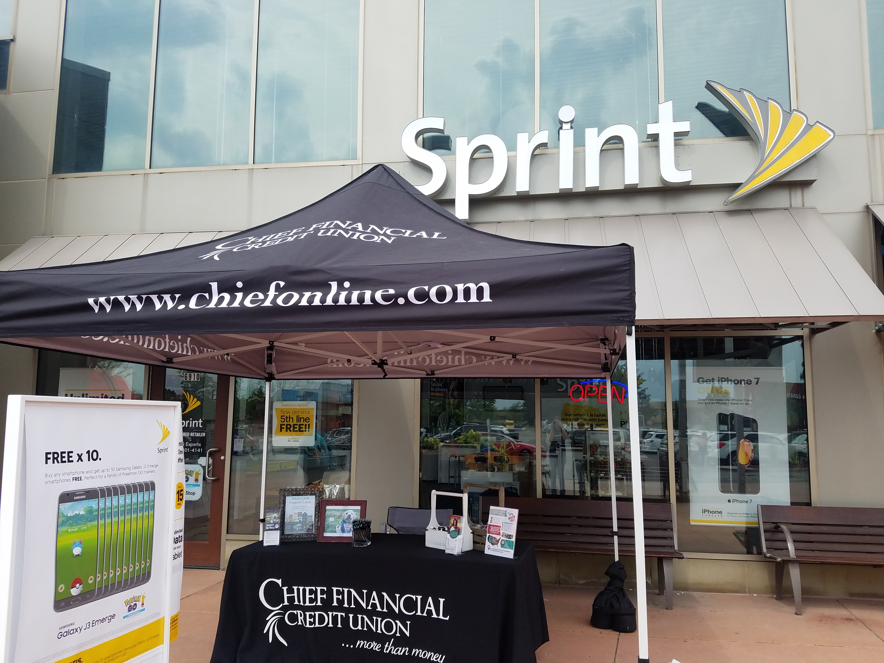
Grow membership
Partner locally with Sprint.
Membership drives at local Sprint store
Credit union branch lobby events
Community events

Slide 18


New revenue model.
New quarterly payouts.
Credit unions will need to fulfill quarterly marketing requirements in order to receive Sprint sales revenue, which is based on program performance.
Love My Credit Union Rewards
provides FREE marketing materials, including a variety of quality digital assets, to help you effectively market the program to your members.

Slide 19
2018 updates
Great ways to market in four easy steps:
Ongoing Website Promotion — Sprint-approved banner ad and link placed on credit union website, preferably the home page, within 30 days of enrollment. Must be continuously displayed for as long as the credit union is enrolled in the program.
Ongoing Lobby Promotion — Place approved lobby materials (digital or print) in all credit union lobbies within 30 days
of enrollment. Must be continuously displayed for as long as the credit union is enrolled in the program.
Employee Communication — Include program information in human resources new hire and employee group packets.
Quarterly Communication Tactics — Execute at least one approved quarterly marketing communication tactic each quarter.

Slide 20
More variety
Quarterly marketing
communication tactics:
Email – Free, ready-to-use HTML templates are provided throughout the year. Promotional emails must be sent to all email addresses on file of credit union members who are at
least 18 years old.
Newsletter article or ad – Free newsletter ads and articles are provided throughout the year. Promotional Sprint articles must be sent through the credit union’s digital or print newsletter to entire circulation.
Social media (organic post, sponsored post or paid ad – Free images, videos and messages are provided regularly. Social media post(s) – whether organic, sponsored or a paid ad — needs to reach 1,000 people or more to meet minimum requirements, and screenshots of results with post date must
be submitted.

Slide 21
Quality digital assets
Quarterly marketing
communication tactics:
Mobile app or online banking banner – Free banner advertisement assets are provided on a routine basis.
Blog post – Free messaging and posts are available.
Gas Station TV advertisements featuring Sprint
promotional offer(s)
Maximize your success! Make sure to take advantage of FREE materials available in the Love My Credit Union Rewards Partner Center and deploy multiple tactics to build momentum.

Slide 22
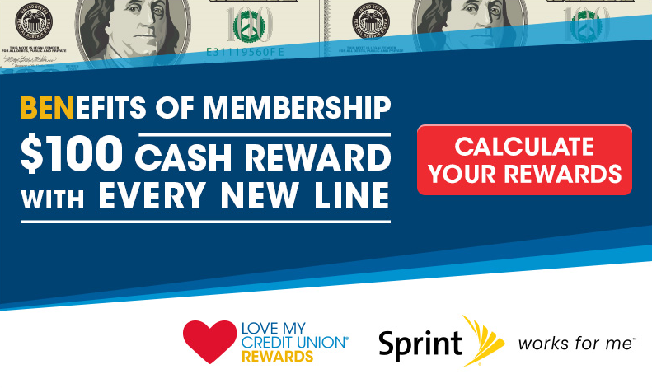
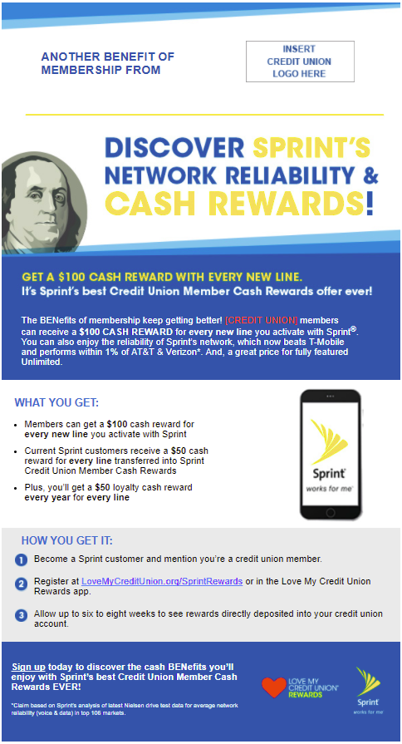
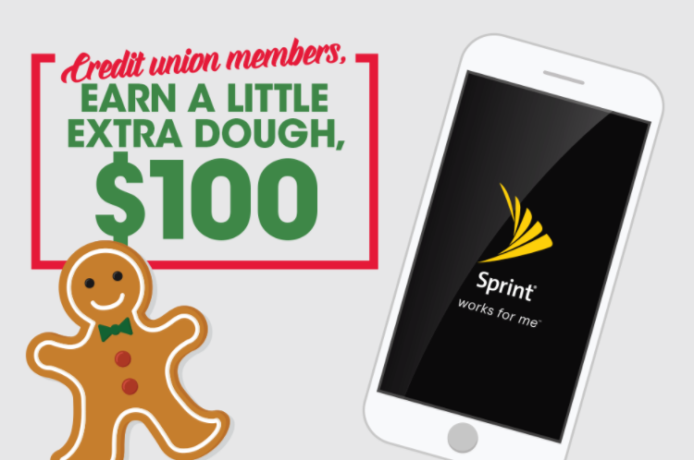
FREE marketing materials
FREE marketing materials always
available in the Partner Center:
Opportunities to co-brand and customize elements
Seasonal campaign assets shared throughout the year

Slide 23

Cash in on your effort.
Credit unions will receive $23 for each new Sprint line activated*.
Credit unions will be paid on performance and must be actively promoting the program per marketing requirements
*New line is a line(s) added when opening a new Sprint account or a new line added within 30 days of account activations

Slide 24

Enroll now
Get started today!
Complete the enrollment form located in the Partner Center
Plan your marketing: Access free marketing materials to promote this exciting offer
Educate your employees, members and local Sprint store staff about this exclusive promotion
Questions? We provide best-in-class client management support.
LoveMyCreditUnion.org/PartnerCenter

Slide 25

Thank you for your time.
For more information, please contact your League or National Business Consultant — NationalSales@CUSolutionsGroup.com

